Slide 1
Quick Detection
and Diagnosis of
Plant Diseases.
Team_ID - T9
Team Name - Clutch
UPES HACKATHON 2019

Slide 2
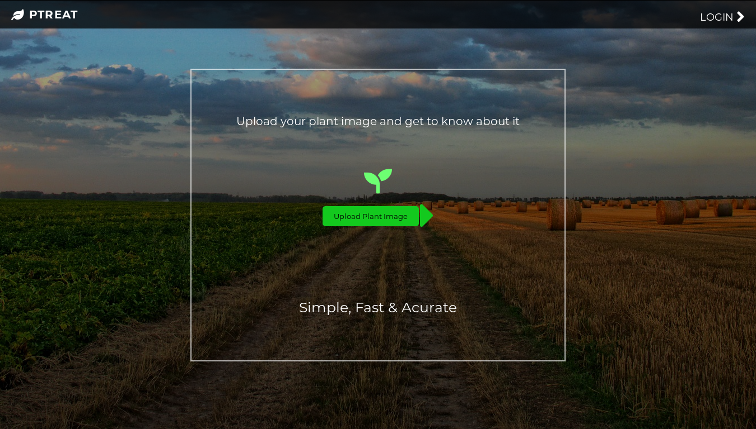

Slide 3
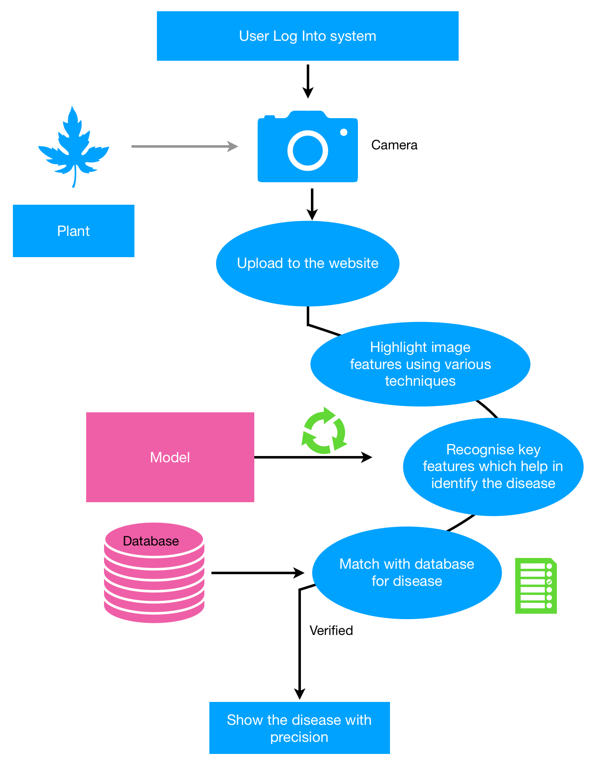
Use Case Diagram & Technology Stack
OpenCV
Deep Learning Libraries, such as Keras with tensorflow backend
Django
Rest API
Numpy,Scipy,Sklearn and python libraries

Slide 4
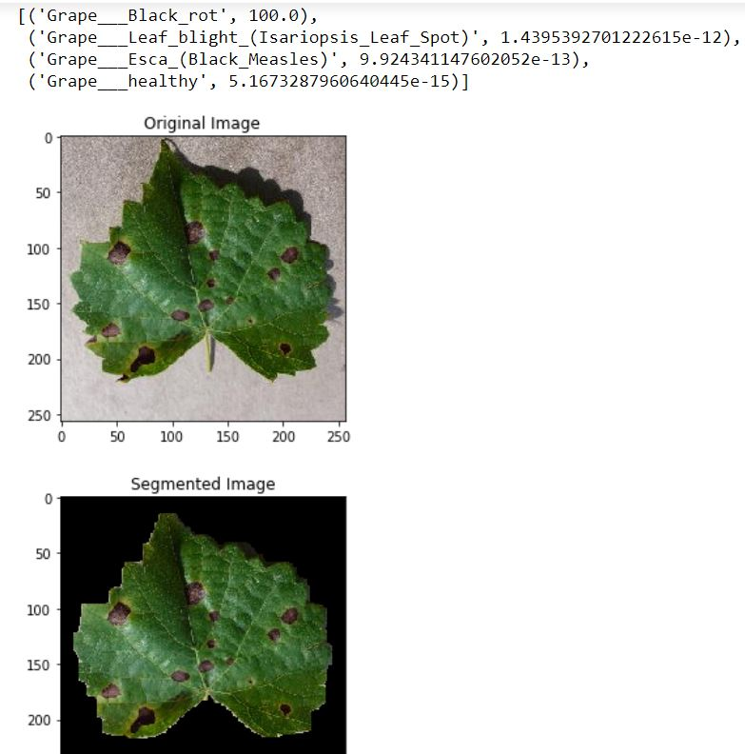
Segmentation Technique
01
We have implemented user guided segmentation using contours and mask to remove background noise.
In the next step, Otsu segmentation is used to automatically perform clustering based image thresholding which helps in obtaining clearly demarcated region of interest from background.
02

Slide 5
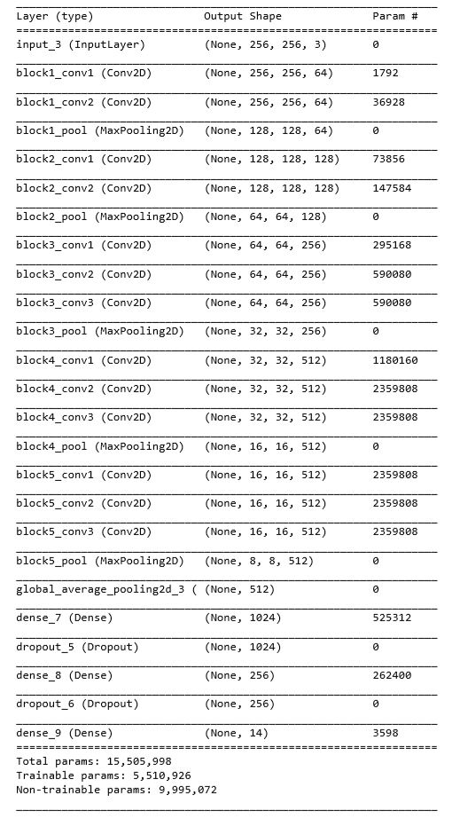
Deep Learning Model (VGG-16)
We chose VGG16 for the purpose of transfer learning in our model by fine tuning on our data. Reason being its ability to extract deep features and it’s is considered to be best of the class model for extracting useful features in ImageNet data.
It outperformed all other models like Googlenet , Resnet and Alexnet in terms of feature extraction and classification for plant disease detection.
TRAINING RESULTS
We have trained our model on different Neural Networks like VGG13 , Alexnet , VGG16 .Out of which VGG16 gives best results with 98.8 % accuracy results across the validation set.
VGG16 is also proved to be the best model to extract useful features in imagenet data.

Slide 6
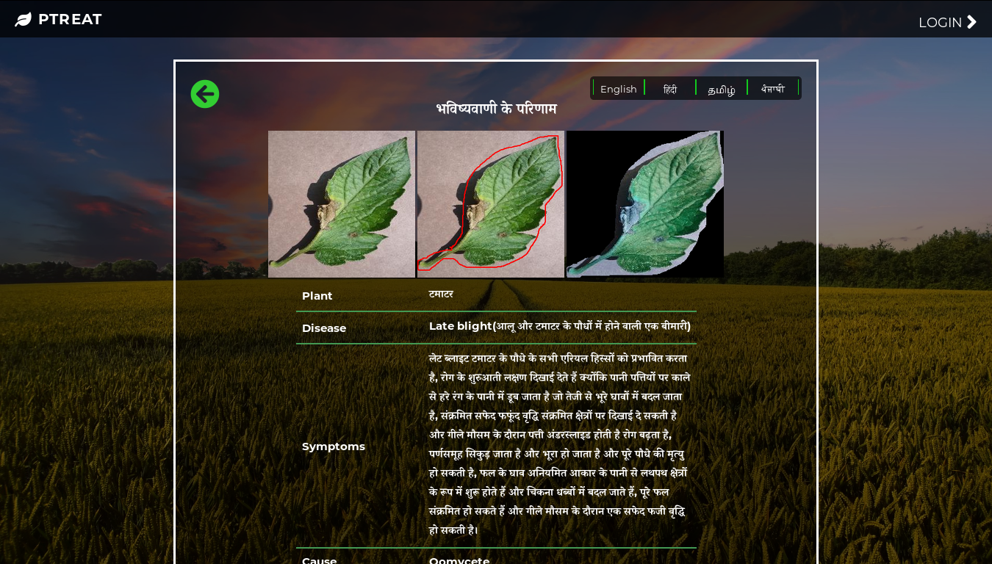
More Insights of Web App

Slide 7
Key Features
In addition to disease prediction, the website recommends steps of control and cure of the disease.
Other probable diseases are also shown.
Website can be translated into many languages as per user convenience.
User can select region of interest themselves from the uploaded image.
Multiple ROIs can be selected with different colors for each region.
The developed website is phone compatible.
Fully Responsive.

Slide 8
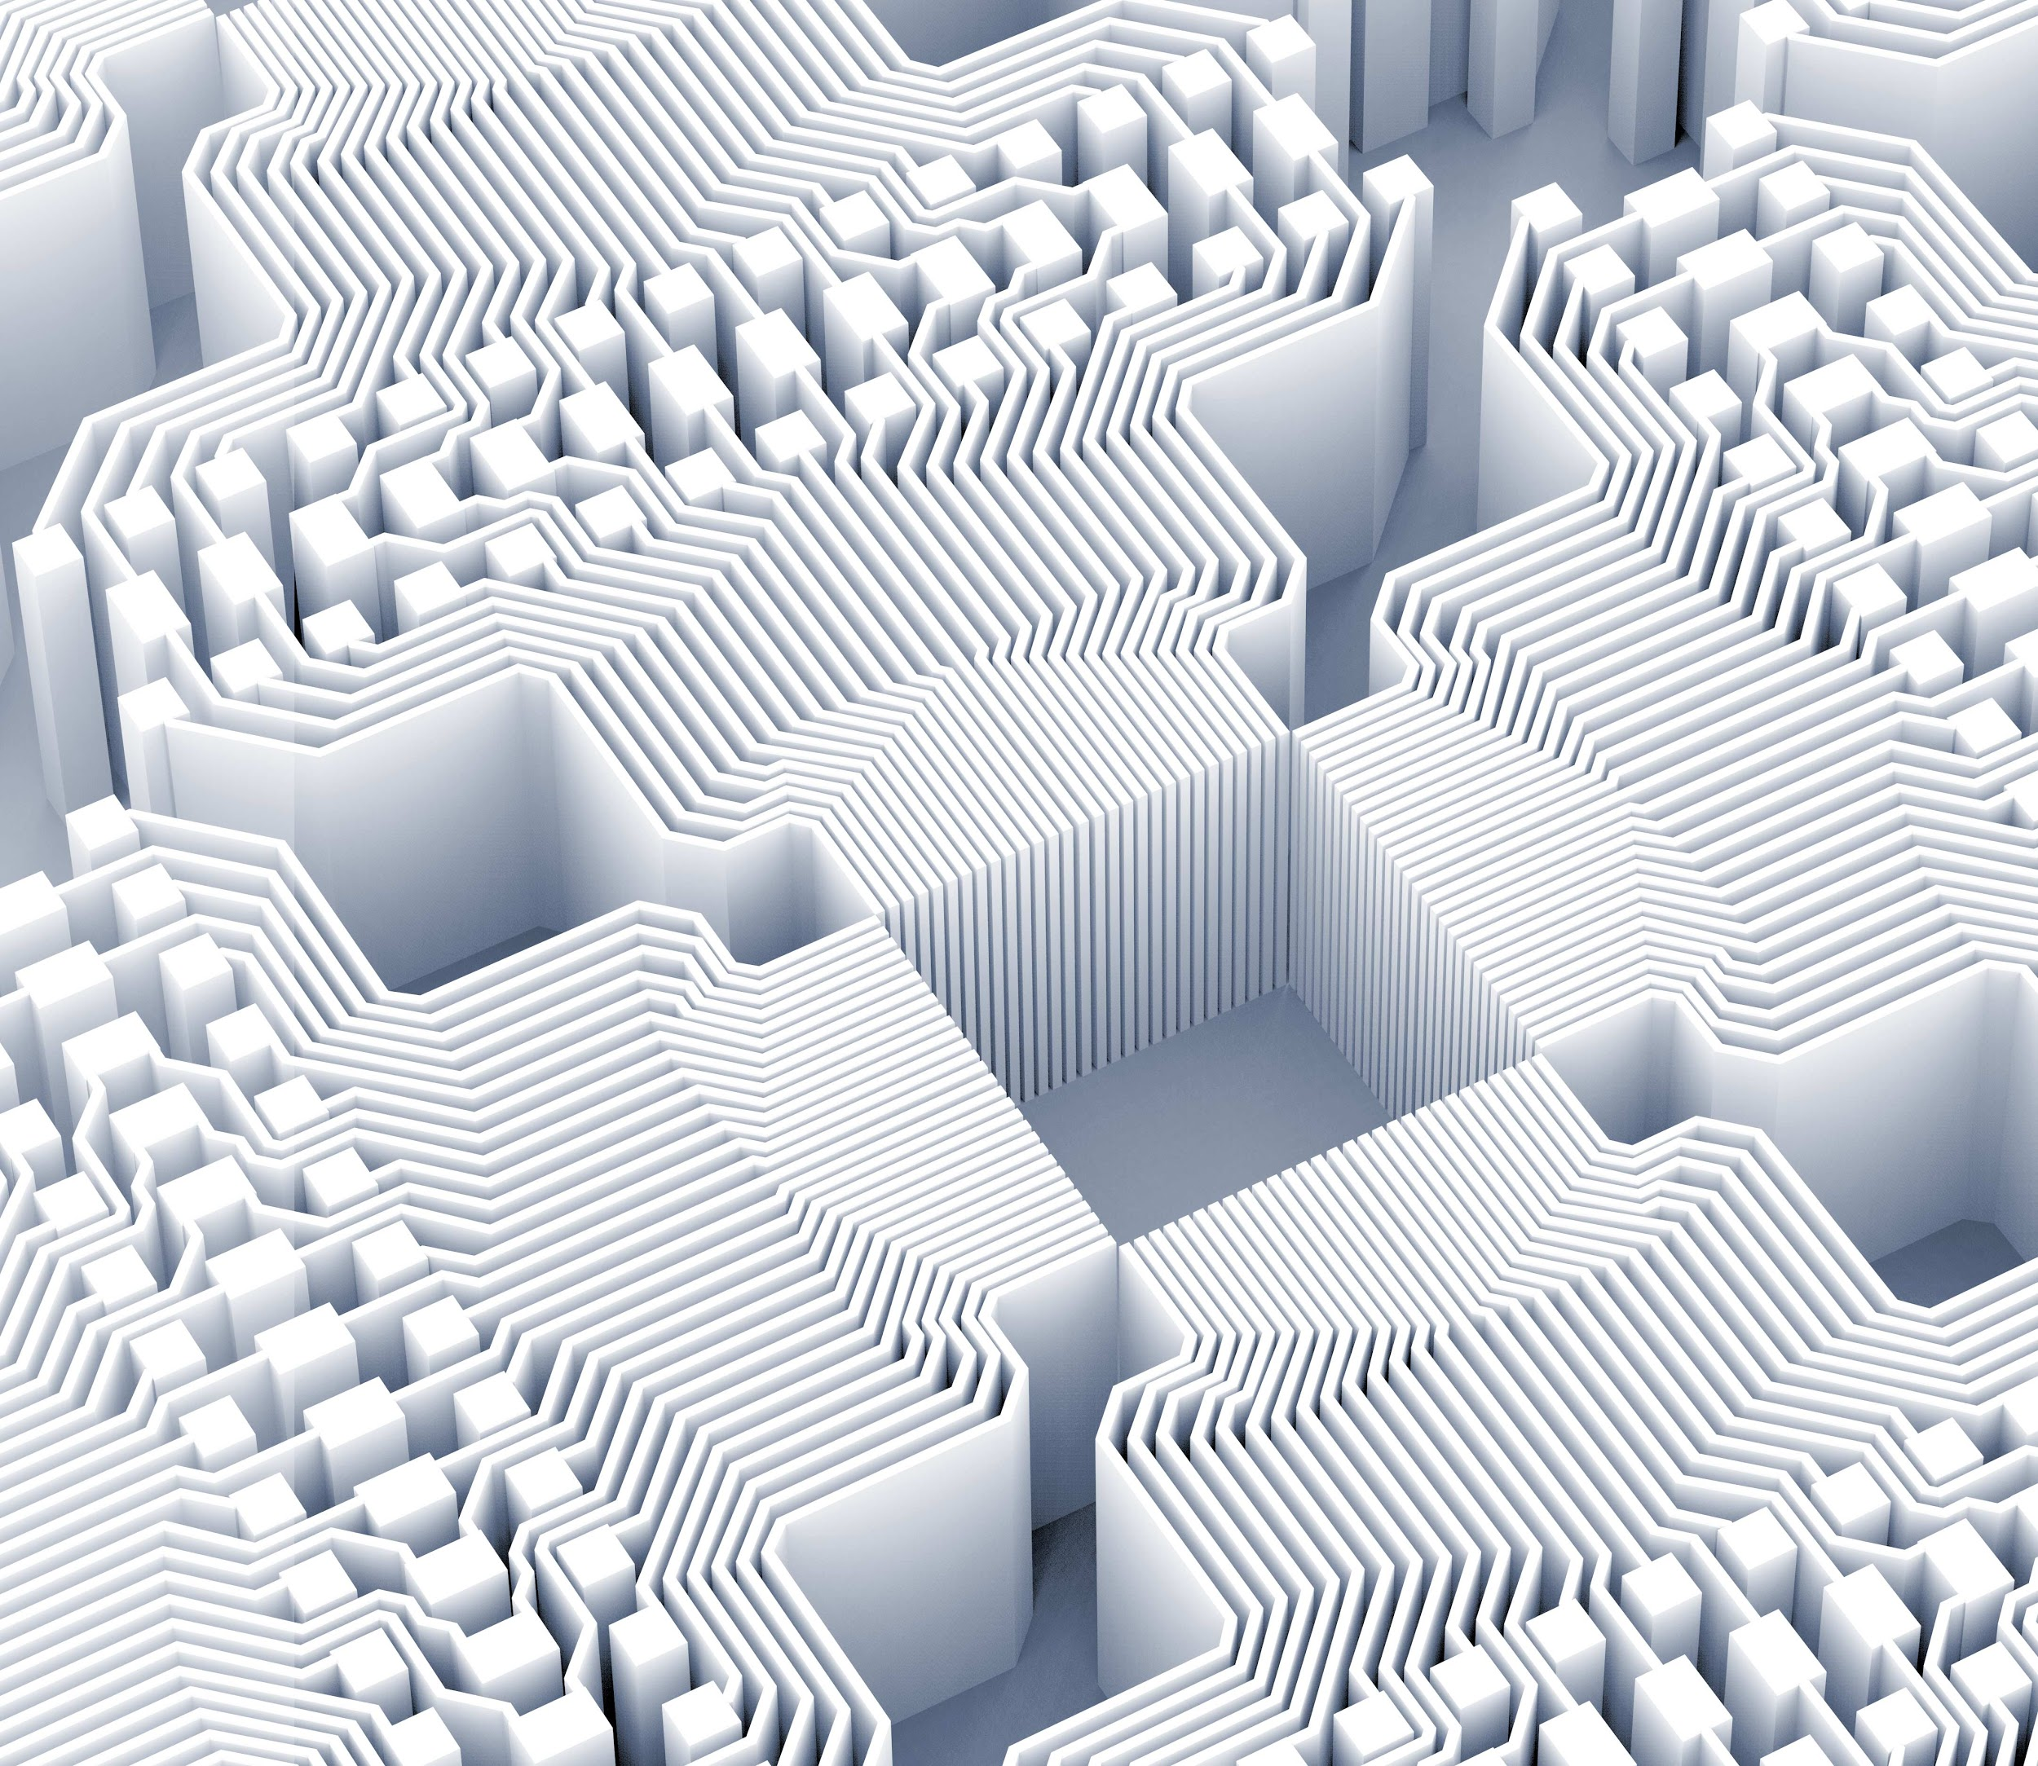
Thank you!

